Slide 1
Does EQAO Ratings Affect Home Prices
Team Members:
Quan Shuang, Bezawit Abebe,
Sayeed Haque, Yen Duong
SCS, University of Toronto
March 13, 2019

Slide 2
Does EQAO Ratings Elementary School Affect Home Prices
In Ontario elementary schools, you must be residing within a school catchment (boundaries) in order to attend the school in that area.
So our main concern it to find whether there isany correlation between school performances and home prices?

Slide 3
Does EQAO Ratings Elementary School Affect Home Prices
Hypothesis:
Is there any correlation between school performance and housing prices. The better the school performance the higher the housing prices.
Research Questions:
Is there any difference in housing prices between different FSAs?
Is there any difference between the average rating of Toronto School Board vs Toronto Catholic school boards
Do the differences in home prices contribute to the educational disparities that occur between low and middle to high-income students?

Slide 4
Does EQAO Ratings Elementary School Affect Home Prices
Data Sets Used and Limitations of Each
Fraser Institute School Rankings
Does not include elementary schools in Ontario that do not enroll Grade 6 students
House Sales in Ontario
Kaggle data set listing prices for the sale of properties (mostly houses) in Ontario
They were obtained for a short period of time in July 2016 only

Slide 5
Does EQAO Ratings Elementary School Affect Home Prices
Data Cleanup & Explorations
Fraser Institute School Rankings
We pulled all the elementary school ratings for both the Toronto District School Board and the Toronto Catholic School Board
House Sales in Ontario
Cleaned the dataset to only have Toronto home prices and ReverseGeo to get postal codes
To make it easier to do the comparisons we decided to take the average school ratings and the average home prices by FSA and we only focused on Toronto

Slide 6
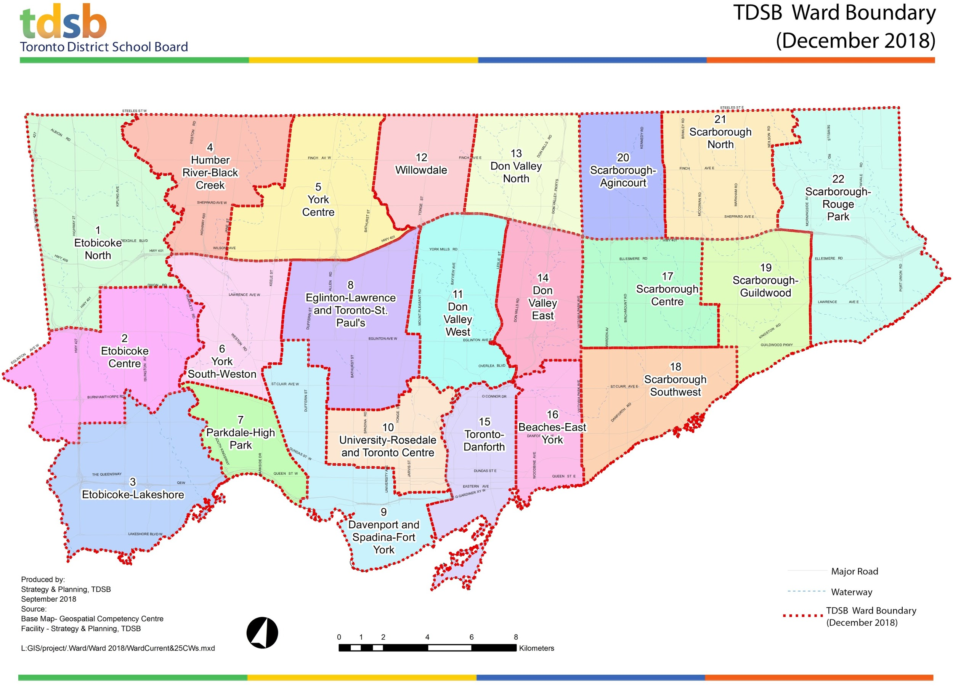

Slide 7
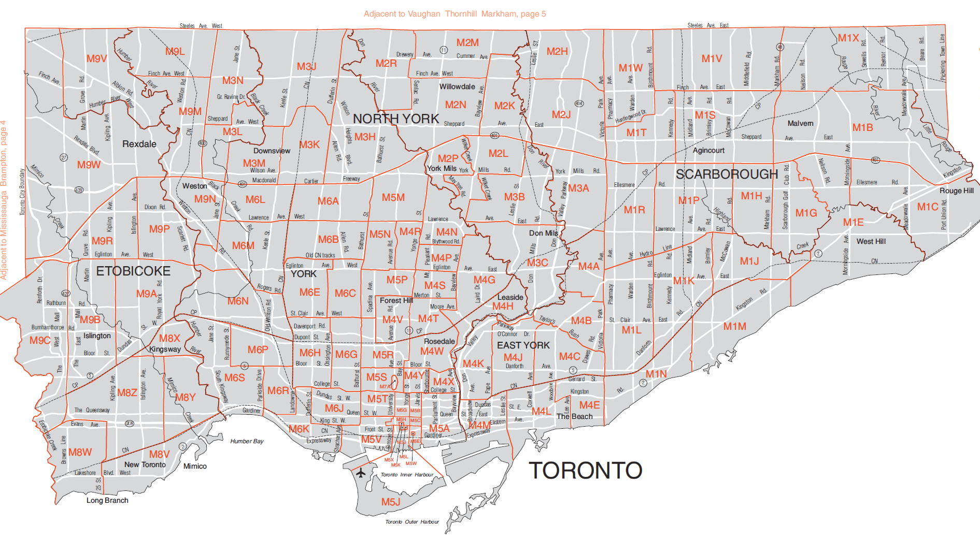
FSA Map of Toronto

Slide 8
Data Analysis
Toronto District Schools (TDSB) vs.
Toronto Catholic District School Board (TCDSB)
We wanted to determine if there was a significant difference between the TDSB vs. TCDSB
Since there are more Toronto schools than Catholic schools we used the average rating per FSA
The mean rating of Toronto Catholic District School Board is 6.034193548387095.
The mean rating of Toronto District School Board is 6.395719844357977
p-value is 0.023301881212982826, so the difference in TDSB means is significant compared to TCDSB.

Slide 9
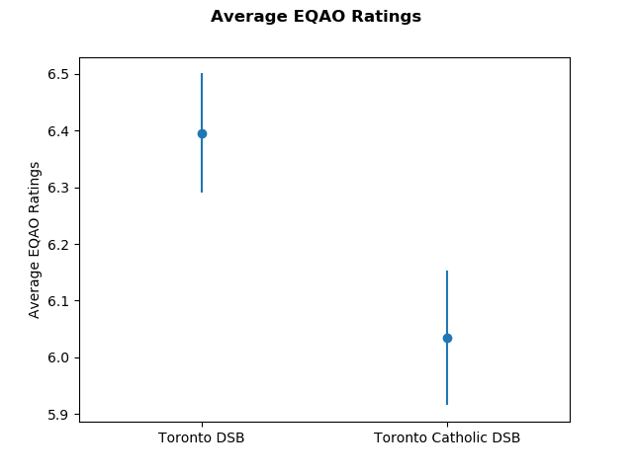
Toronto District Schools (TDSB) vs. Toronto Catholic District School Board (TCDSB)

Slide 10
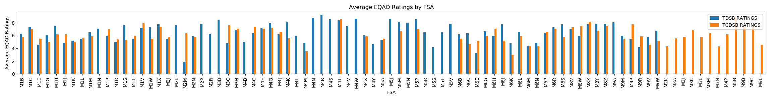
Toronto District Schools (TDSB) vs. Toronto Catholic District School Board (TCDSB)

Slide 11
Data Analysis
Average Housing Prices per FSA
In order to determine whether there is a correlation between the average school ratings with a given FSA and the housing prices we first needed to check to see if there was any noticable differences between housings prices per FSA.
We chose to use a bar graph to visualize this data as the difference in bar heights would provide clear indicators of any noticeable variation between the average housing prices per FSA
The data graph ended up showing enough clear spikes in bar heights for us to conclude there is in fact noticeable variation in housing prices depending on which FSA you are located in.

Slide 12
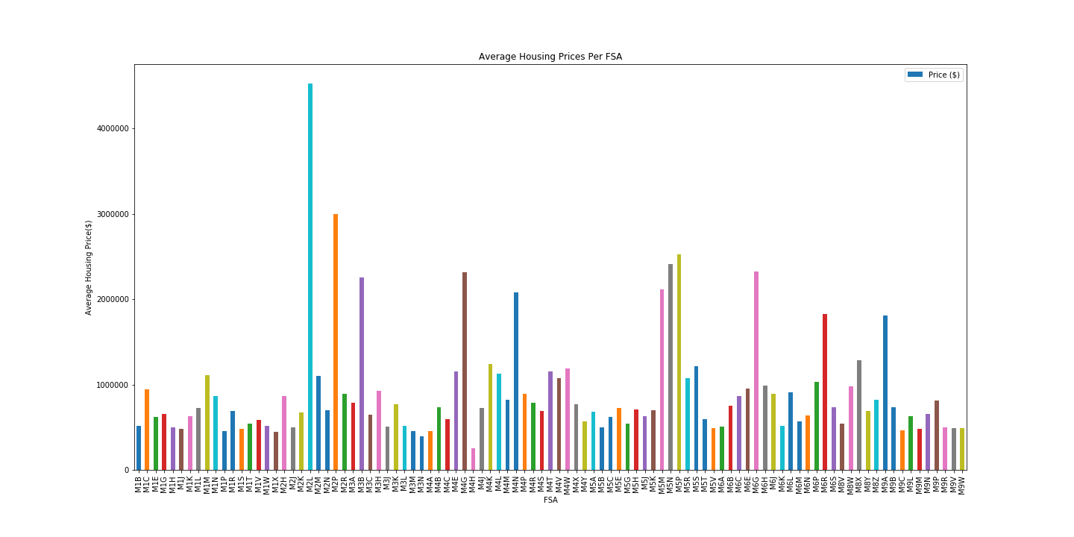
Average Housing Prices Per FSA

Slide 13
Data Analysis
Average Housing Pricing vs Average School Board Rating
Next we compared the average housing prices per FSA with the average EQAO ratings.
We did this comparison for the Toronto District School Board, the Catholic District School board as well as a combination of both to see if there are any variations amongst them.
We chose scatter plots to visualize this data, and used a line of best fit to see if a trend can be observed.
Overall we do see an clustering around the line of best fit for the majority of the data points, and the line of best fit showing an upward slope for all 3 visualizations

Slide 14
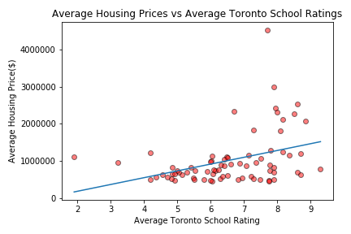
Average Housing Pricing vs Average Toronto School Rating

Slide 15
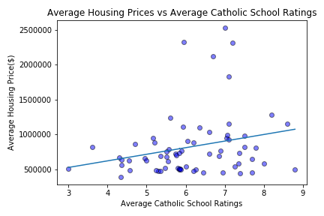
Average Housing Pricing vs Average Catholic School Rating

Slide 16
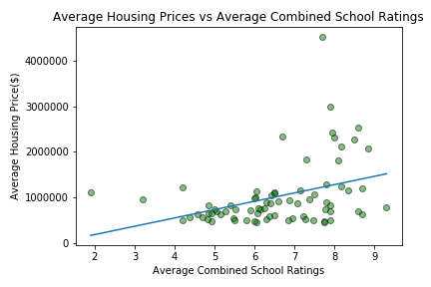
Average Housing Pricing vs Average Combined School Rating

Slide 17
Data Analysis
Top ten EQAO ranking schools vs. House Prices
From the following heatmap you can see that the majority of the top 10 ranking schools from both school boards are located in areas with high housing prices surrounding them.

Slide 18
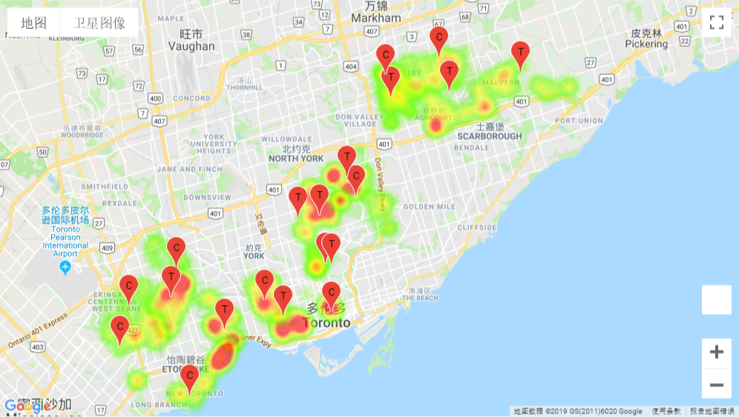
Top 10 Schools vs House Prices in Same FSA

Slide 19
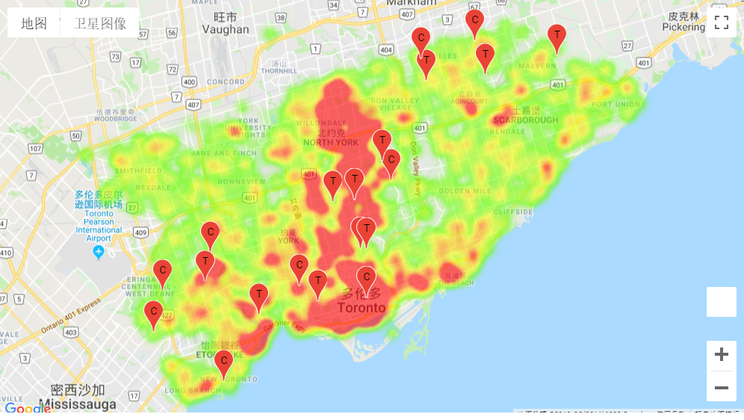
Top 10 Schools vs House Prices in All FSA

Slide 20
Data Analysis
Bottom ten ranking schools vs. House Prices
From the following heatmap you can see that the majority of the bottom 10 ranking schools from both school boards fall into low housing price areas with the exception of schools in high desirable areas regardless like downtown Toronto

Slide 21
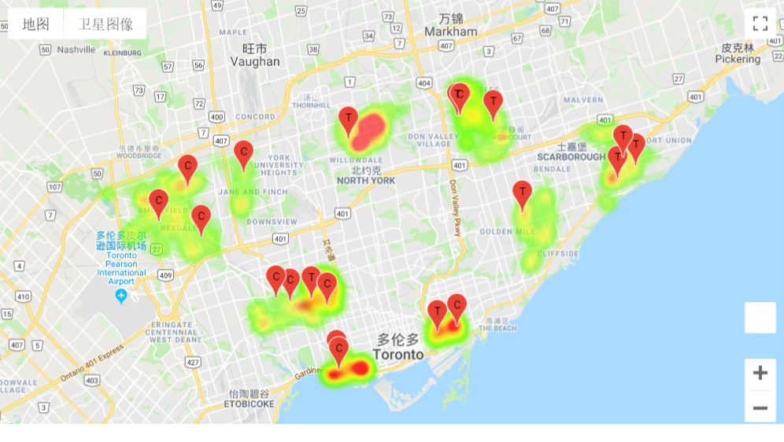
Bottom 10 Schools vs House Prices in Same FSA

Slide 22
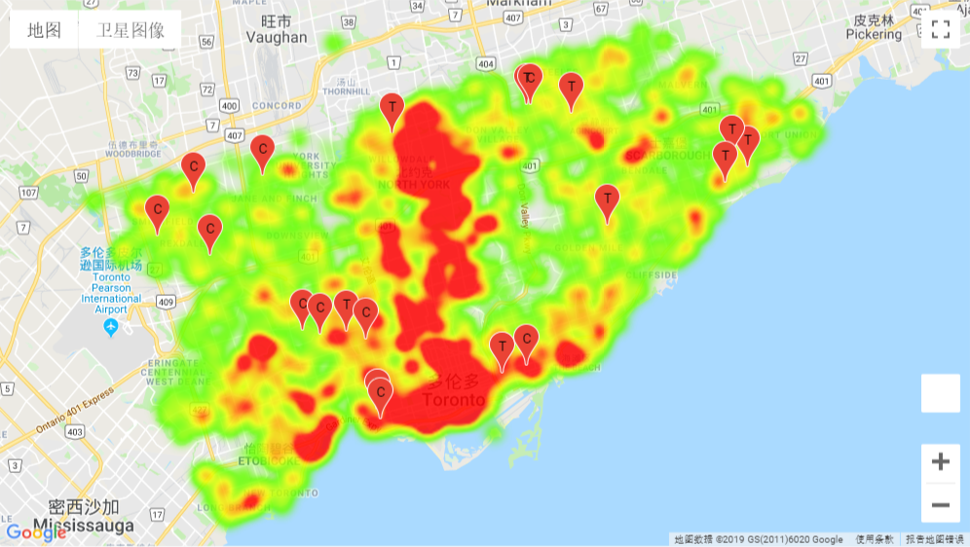
Bottom 10 Schools vs House Prices in Same FSA

Slide 23
Conclusion
In a strong housing market like Toronto demand is high no matter where you are in the city, however, from our findings we feel that houses that fall in the catchment of high performing EQAO schools does drive up the house prices in a given area.
Due to the limited time we were not able to look for a better dataset that would be a better indicator of education disparity in marginalized areas vs. high income areas. A better indicator would be household income for each FSA
Also, Fraser Institute rankings does not take into account many important demographic factors, such as English as a Second Language population, students with special education needs or the social risk index.

